Slide 1
Computational Photography 5
Depth Blurring and Deblurring and using lots of images

Slide 2
Why are our images blurry?
Lens imperfections.
Camera shake.
Scene motion.
Depth defocus.
last lecture: deconvolution
conventional photography
last lecture: blind deconvolution
flutter shutter, motion-invariant photo
coded photography
coded aperture, focal sweep, lattice lens

Slide 3
Why are our images blurry?
Lens imperfections.
Camera shake.
Scene motion.
Depth defocus.
last lecture: deconvolution
conventional photography
last lecture: blind deconvolution
flutter shutter, motion-invariant photo
coded photography
coded aperture, focal sweep, lattice lens

Slide 4
Dealing with depth blur: coded aperture

Slide 5
Defocus blur
Point spread function (PSF): The blur kernel of a (perfect) lens at some out-of-focus depth.
blur kernel
object distance D
focus distance D’
What does the blur kernel depend on?

Slide 6
Defocus blur
Point spread function (PSF): The blur kernel of a (perfect) lens at some out-of-focus depth.
blur kernel
object distance D
focus distance D’
Aperture determines shape of kernel.
Depth determines scale of blur kernel.

Slide 7
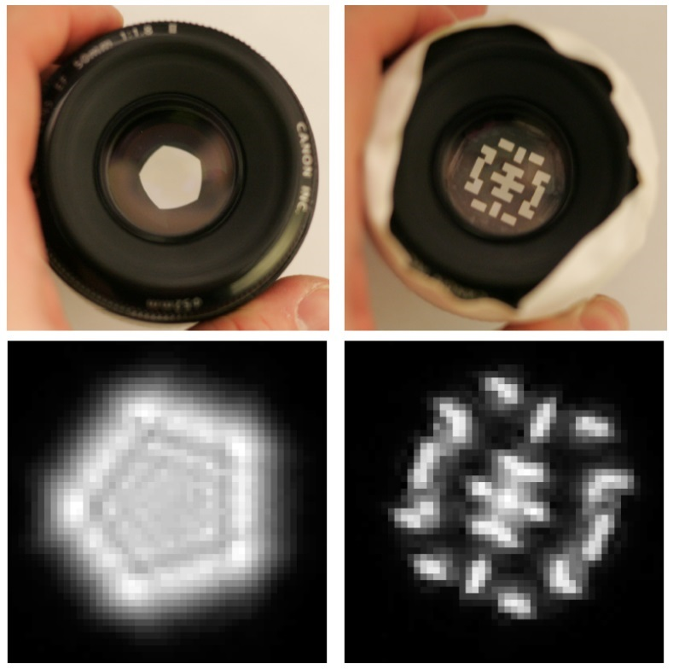
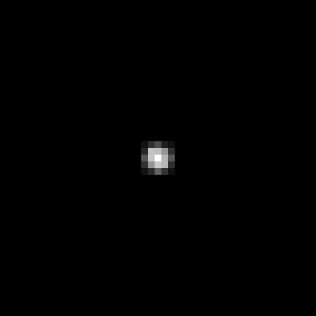
Depth determines scale of blur kernel
PSF
object distance D
focus distance D’

Slide 8
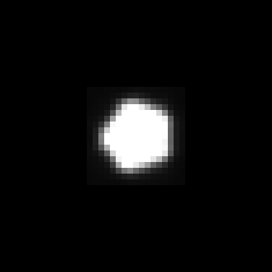
Depth determines scale of blur kernel
PSF
object distance D
focus distance D’

Slide 9
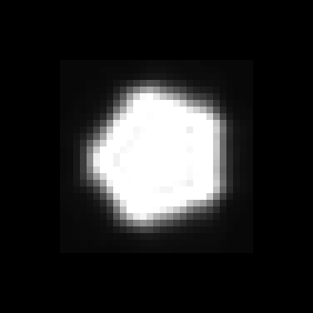
Depth determines scale of blur kernel
PSF
object distance D
focus distance D’

Slide 10
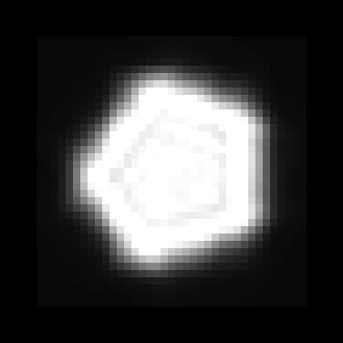
Depth determines scale of blur kernel
PSF
object distance D
focus distance D’

Slide 11
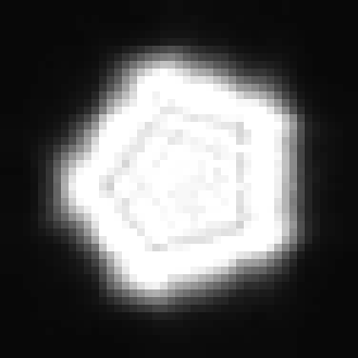
Depth determines scale of blur kernel
PSF
object distance D
focus distance D’

Slide 12
Aperture determines shape of blur kernel
PSF
object distance D
focus distance D’

Slide 13

Aperture determines shape of blur kernel
What causes these lines?
PSF
photo of aperture
shape of aperture
(optical transfer function, OTF)
blur kernel
(point spread function, PSF)
How do the OTF and PSF relate to each other?

Slide 14
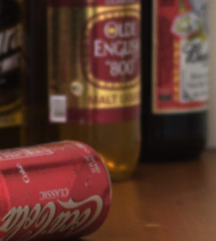
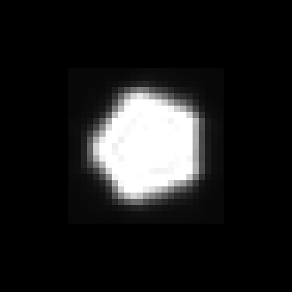
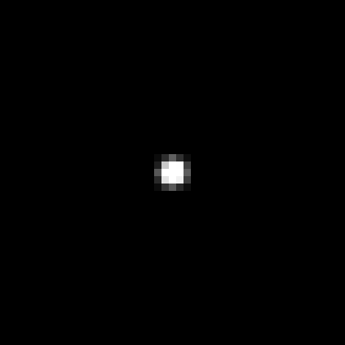
Removing depth defocus
measured PSFs at different depths
input defocused image
How would you create an all in-focus image given the above?

Slide 15
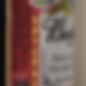
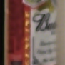

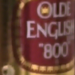
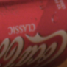

Removing depth defocus
Defocus is local convolution with a depth-dependent kernel
=
depth 3
*
=
input defocused image
depth 2
*
=
depth 1
*
measured PSFs at different depths
How would you create an all in-focus image given the above?

Slide 16
Removing depth defocus
Defocus is local convolution with a depth-dependent kernel
=
depth 3
*
=
input defocused image
depth 2
*
=
depth 1
*
measured PSFs at different depths
How would you create an all in-focus image given the above?

Slide 17
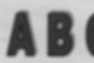
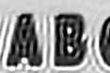

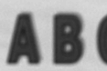
Removing depth defocus
Deconvolve each image patch with all kernels
Select the right scale by evaluating the deconvolution results
⁻¹
=
*
⁻¹
=
How do we select the correct scale?
*
⁻¹
=
*

Slide 18
Removing depth defocus
Problem: With standard aperture, results at different scales look very similar.
⁻¹
=

*
wrong scale
⁻¹
=
?
*
correct scale
⁻¹
=
?
*
correct scale

Slide 19
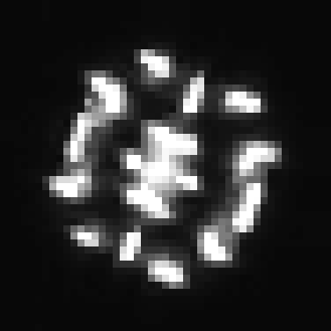
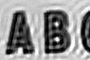
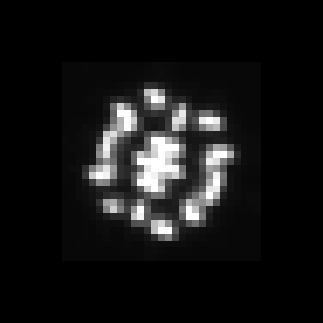


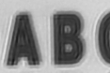
Coded aperture
Solution: Change aperture so that it is easier to pick the correct scale
⁻¹
=

*
wrong scale
⁻¹
=

*
correct scale
⁻¹
=

*
wrong scale

Slide 20
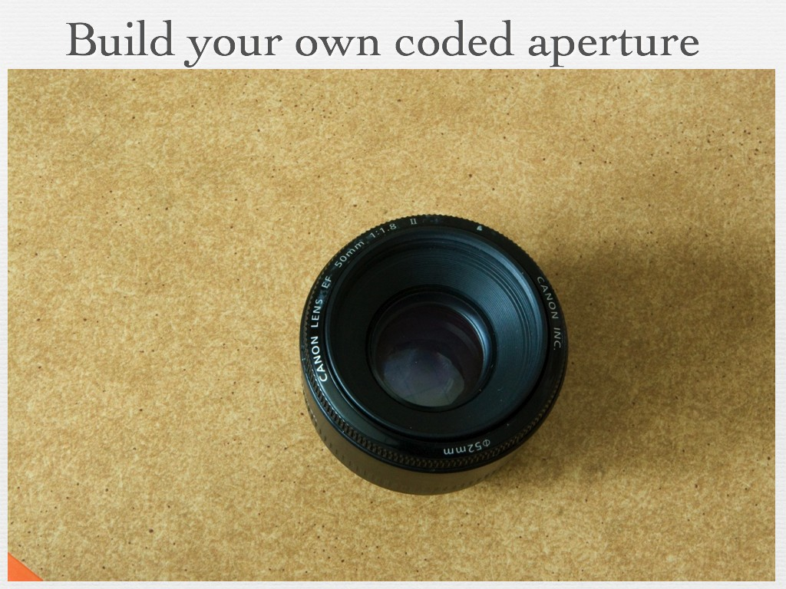
Notes:
This is made possible with a simple modification to conventional images: inserting into the lens aperture a coded pattern which we cut from a piece of cardboard. A quick assembly manual is: open the lens, place a cardboard mask in the aperture and close it up.

Slide 21
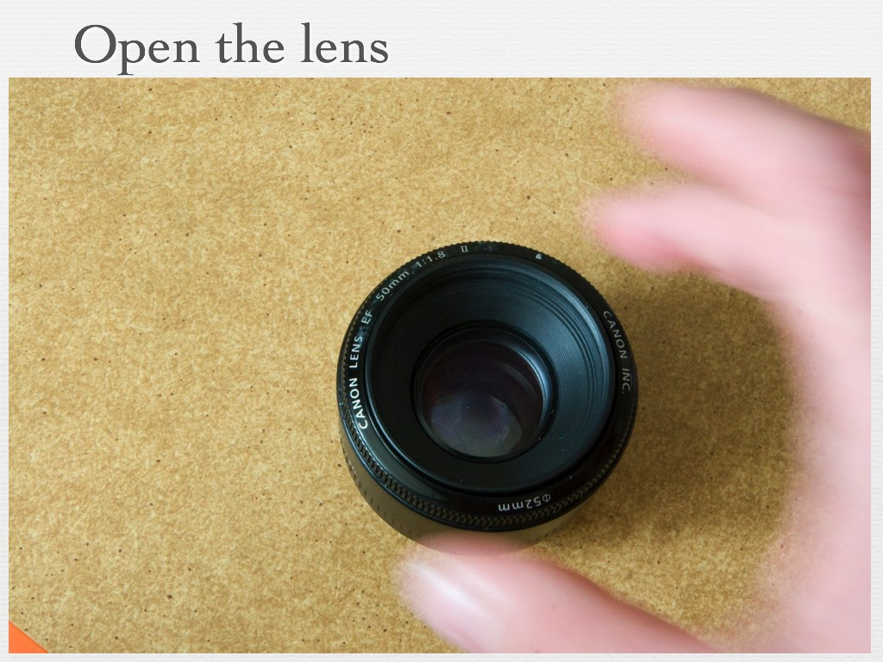
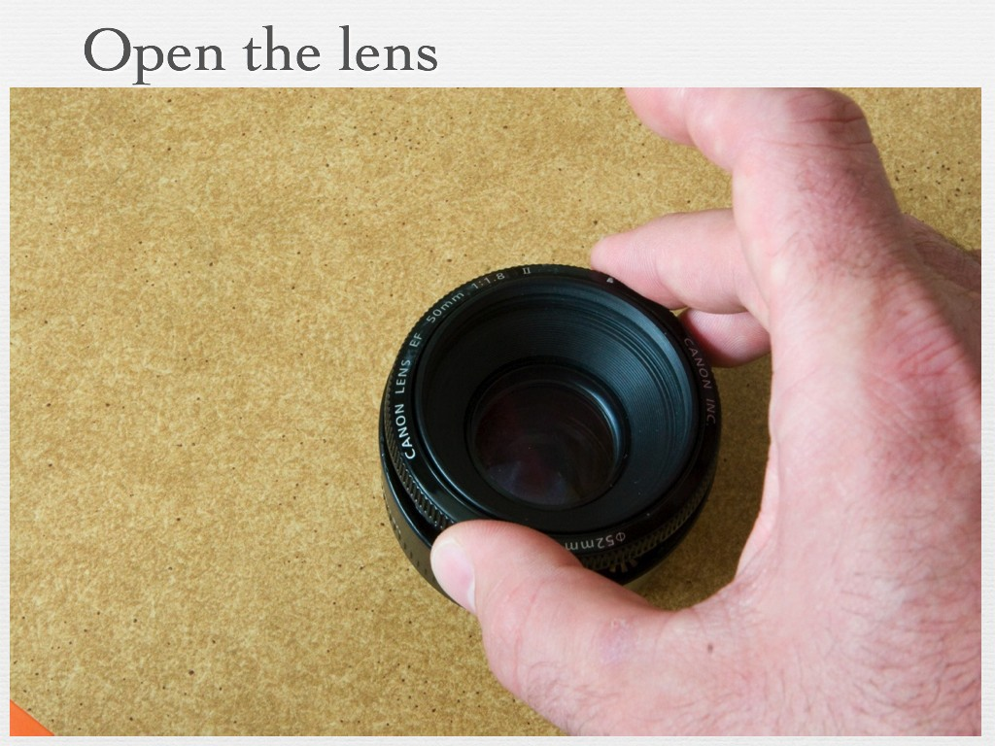
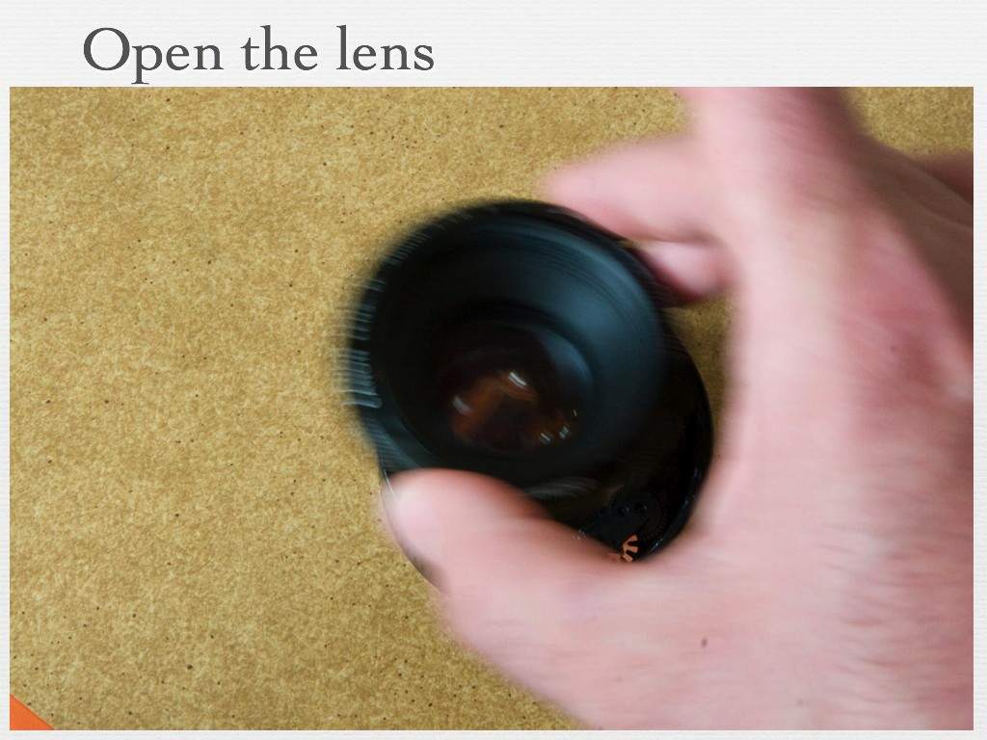
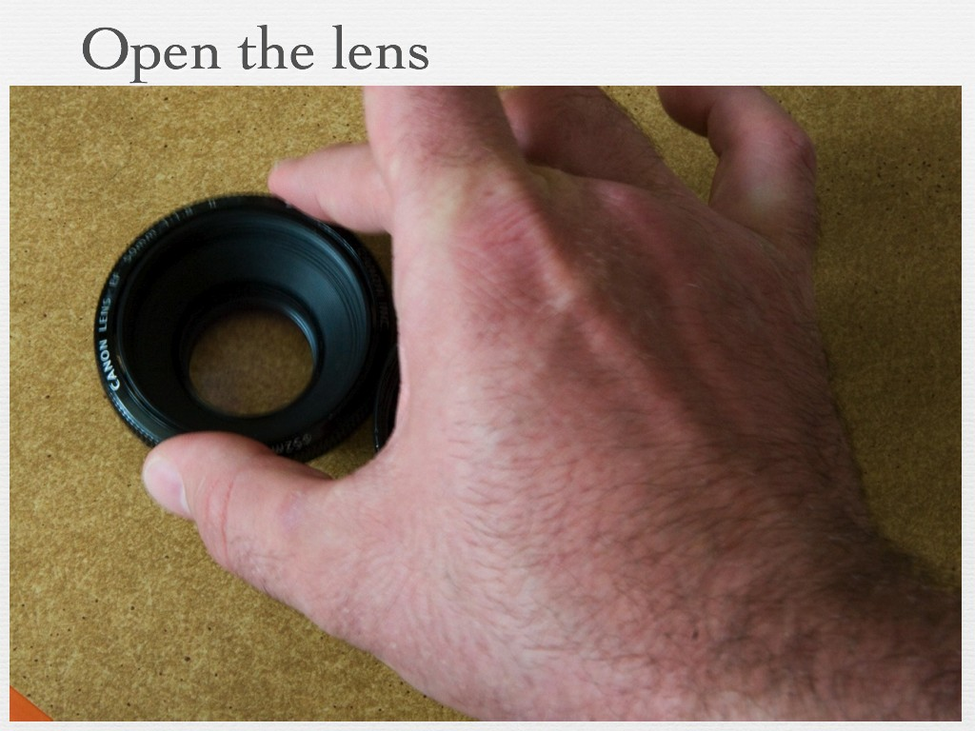
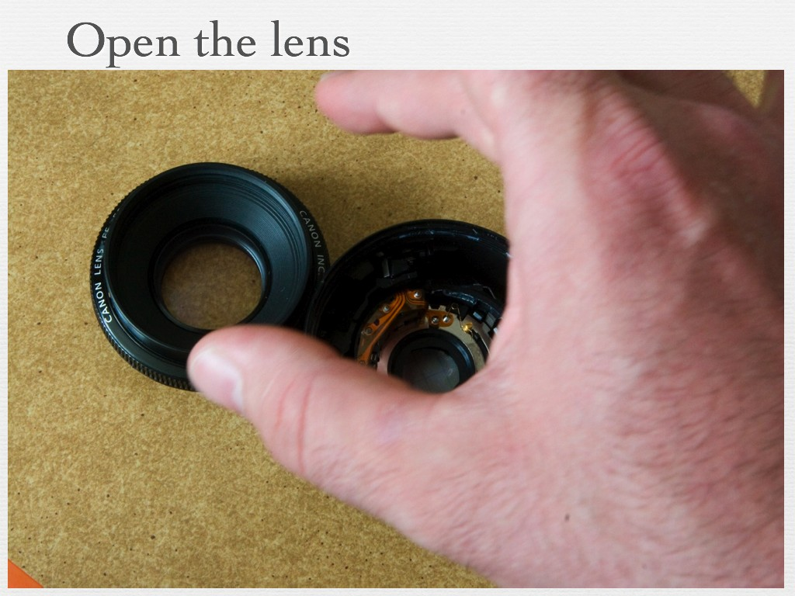
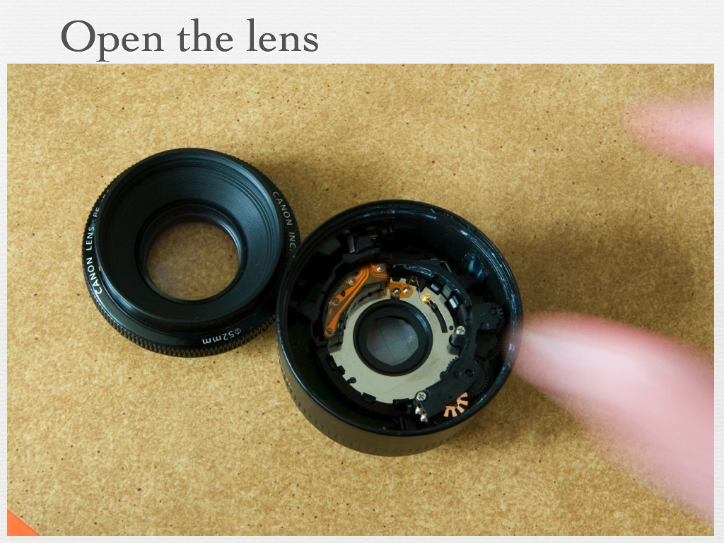
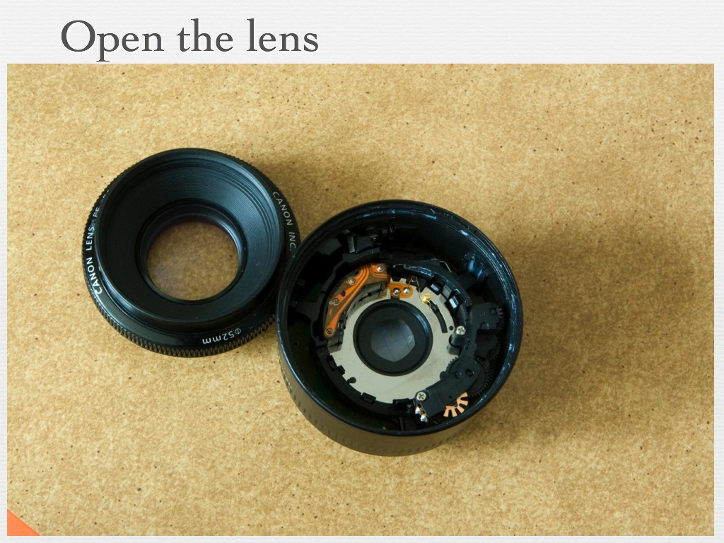
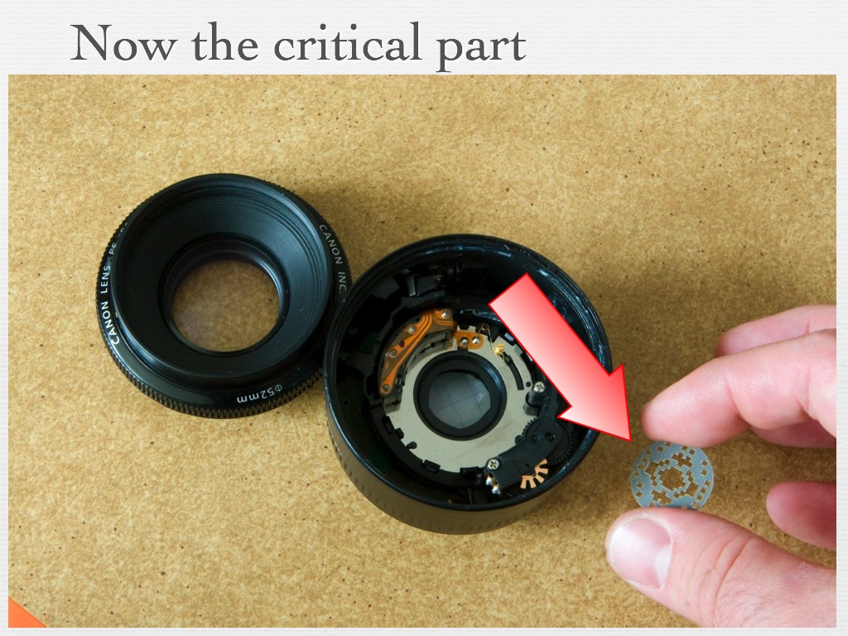
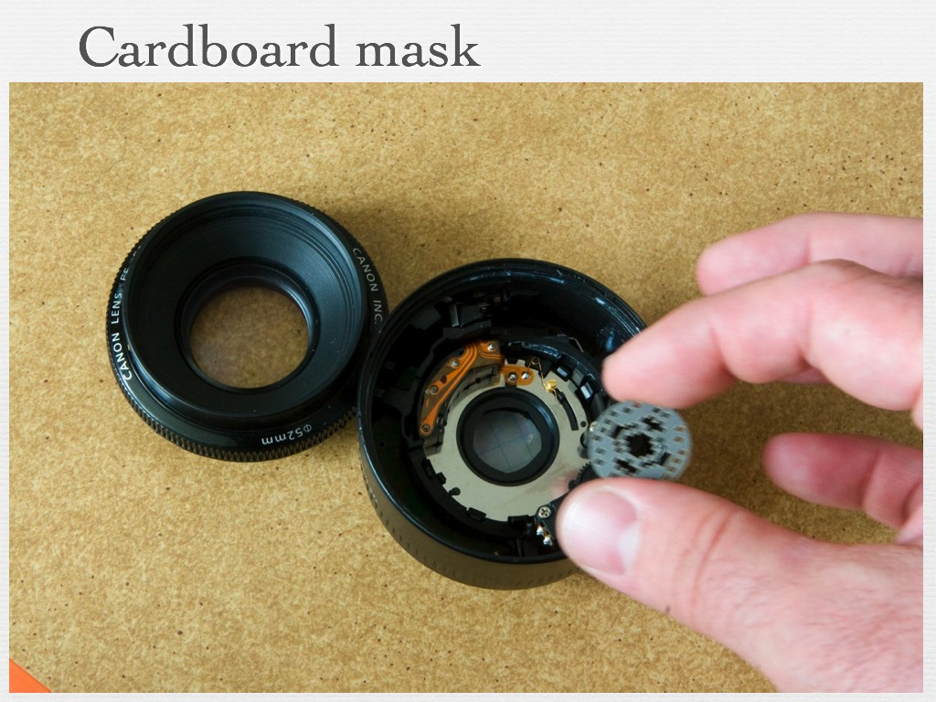
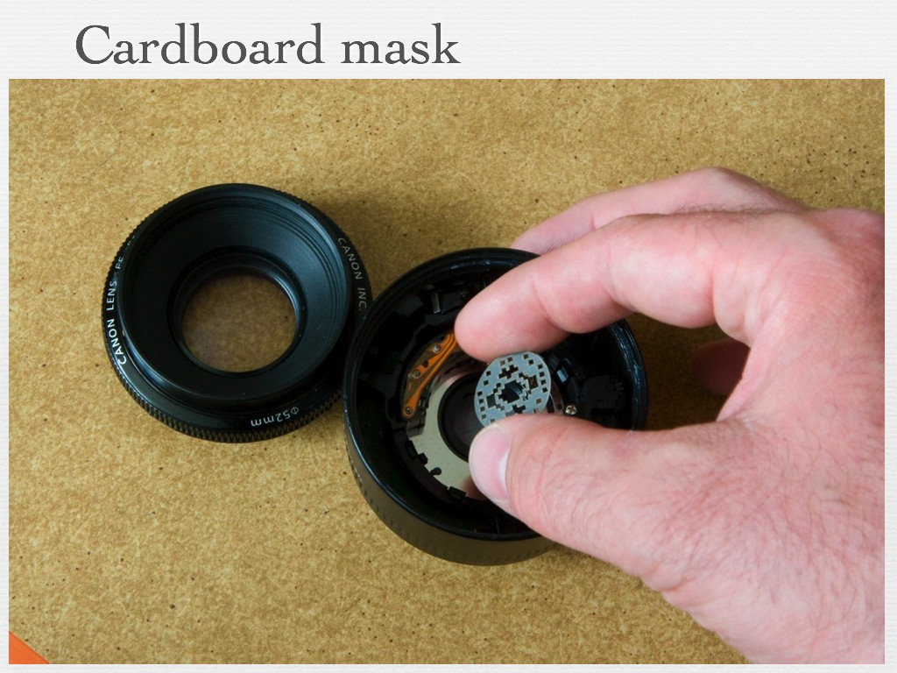
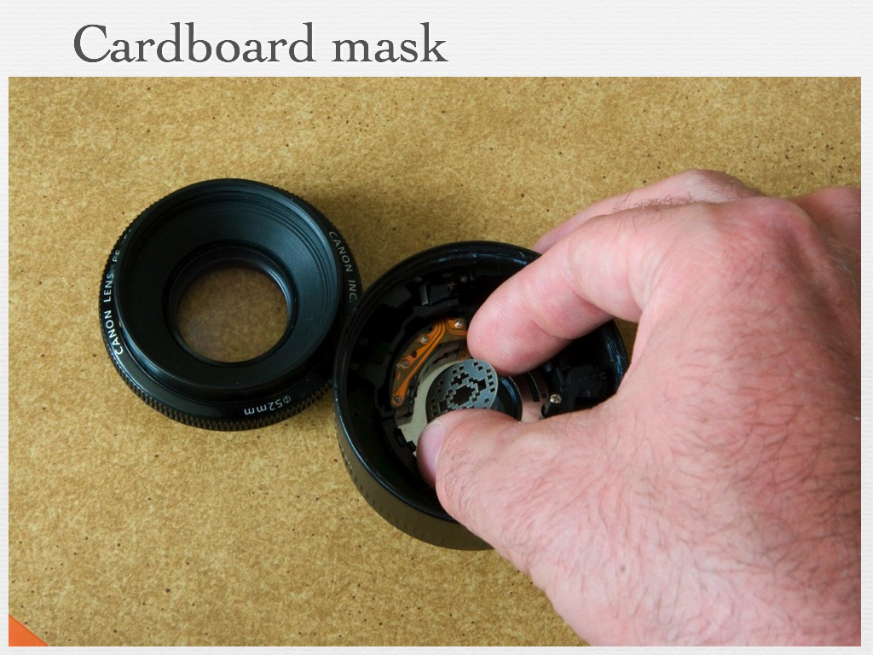
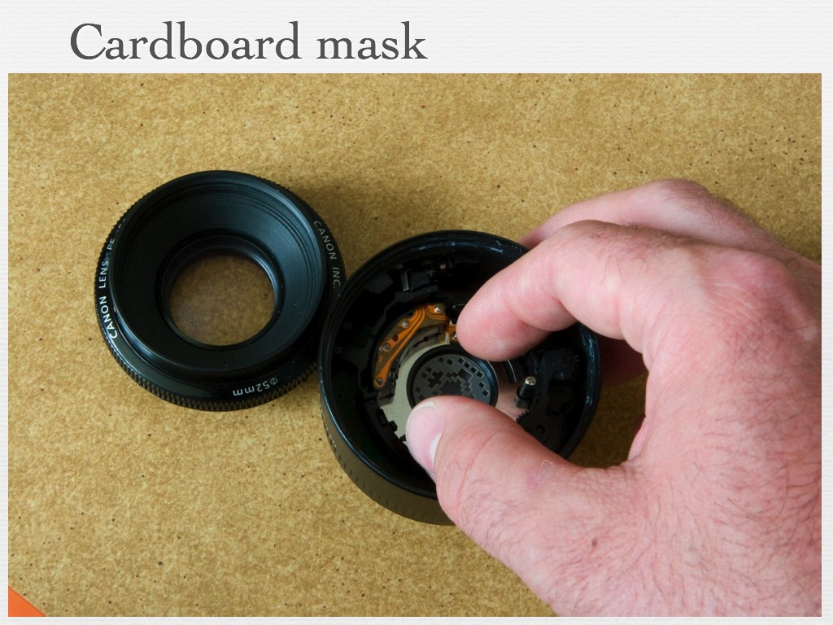
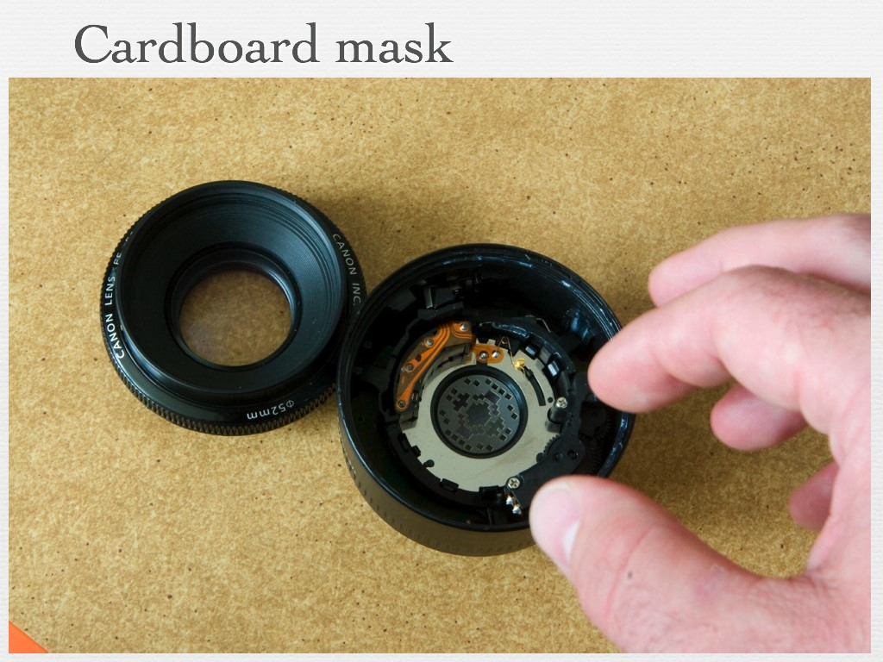
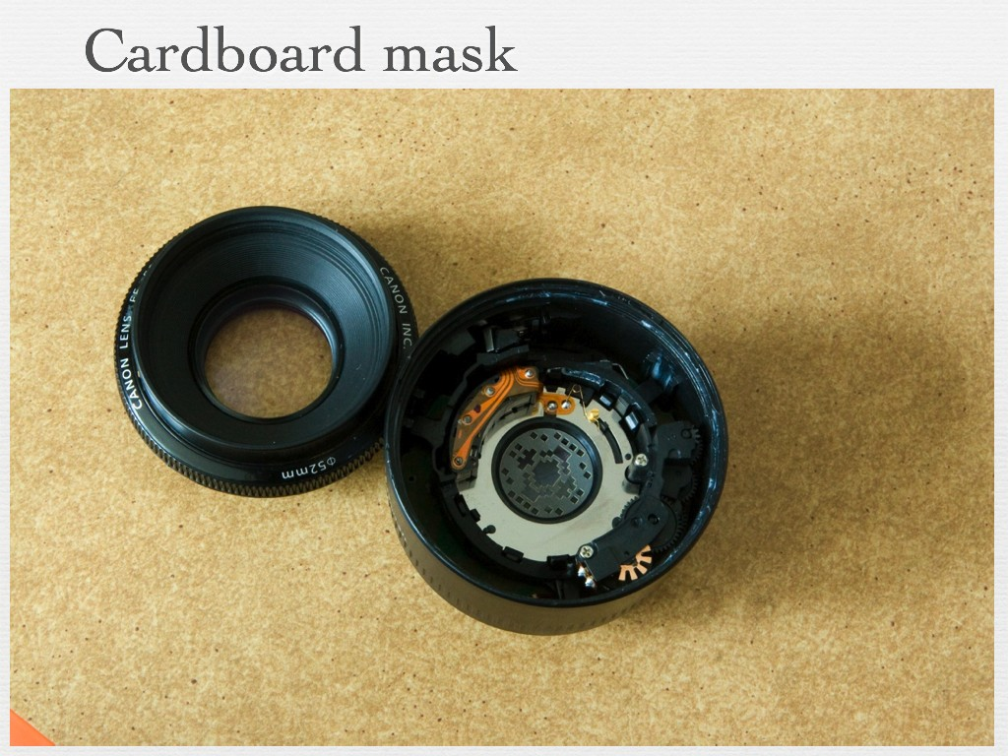
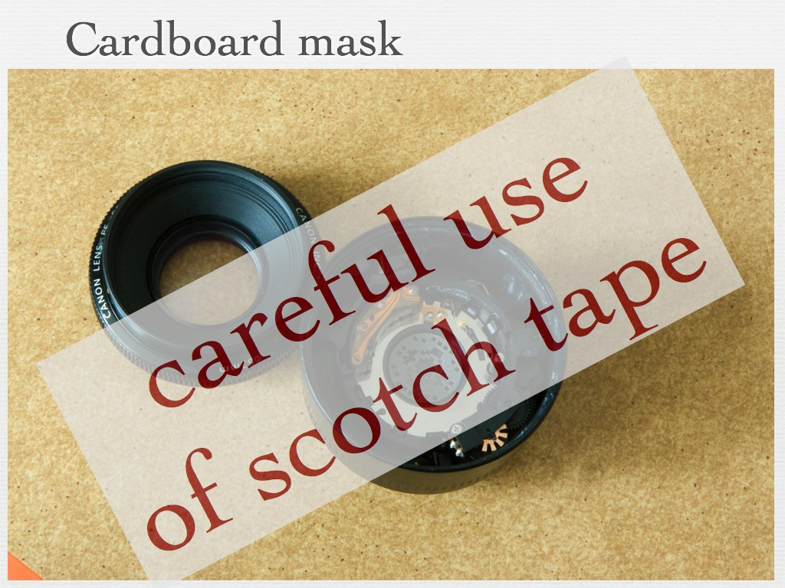
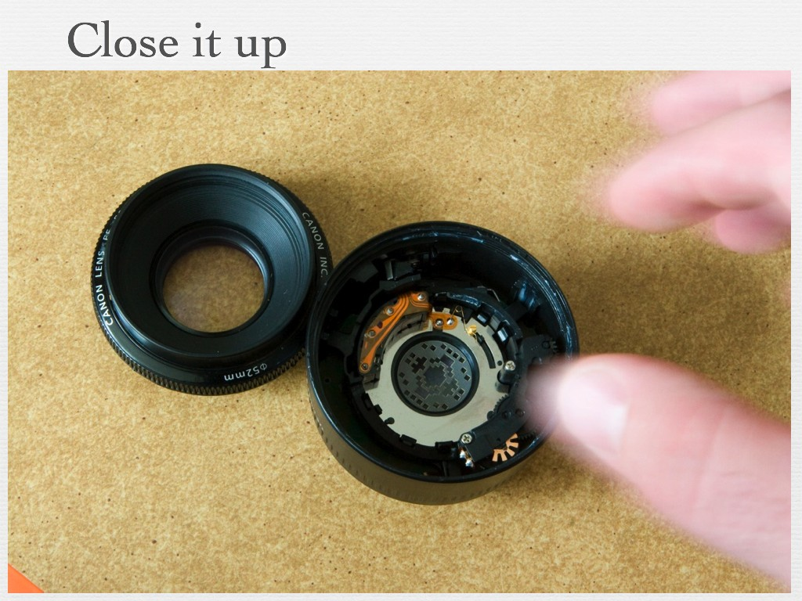
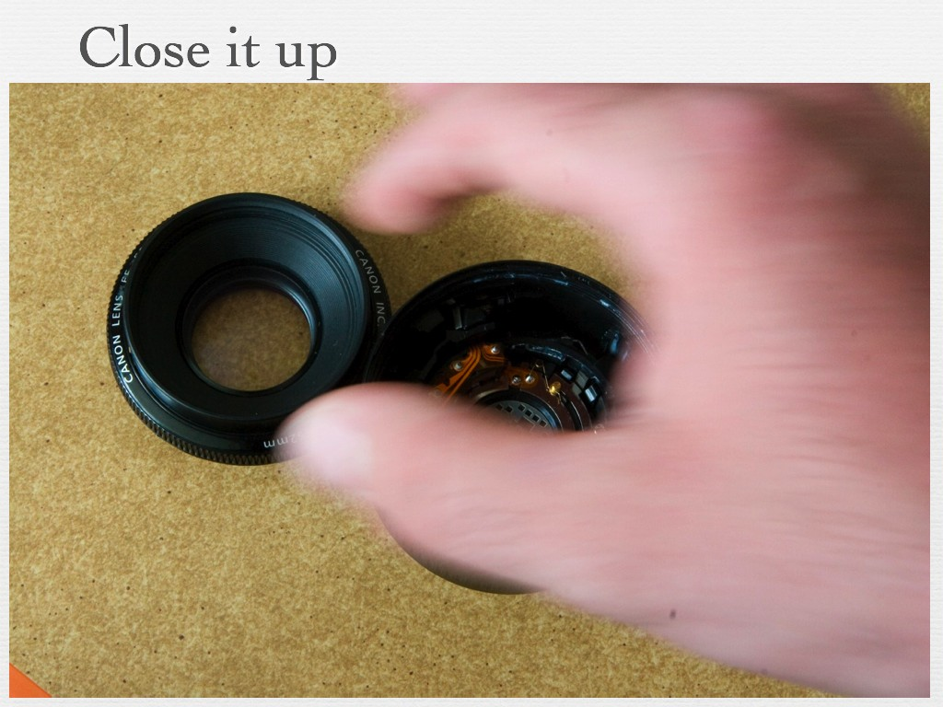
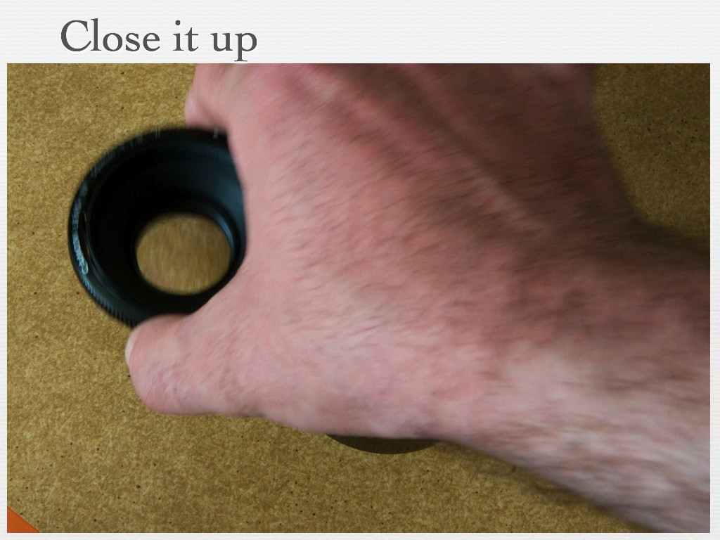
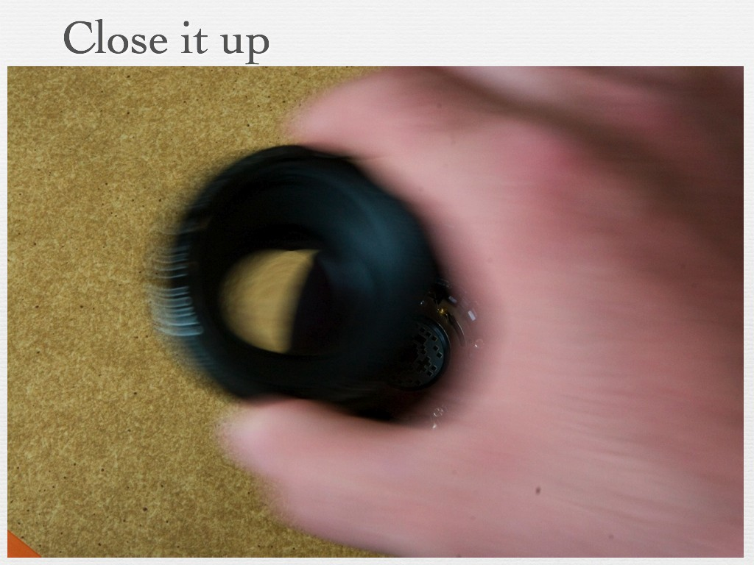
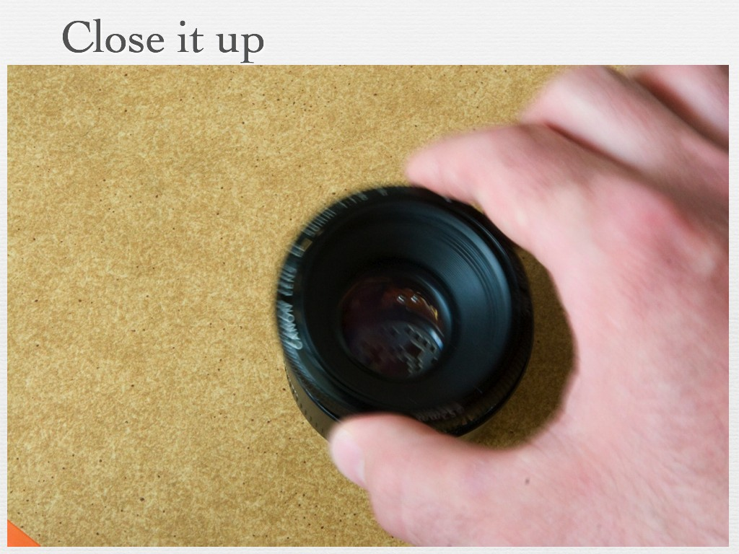
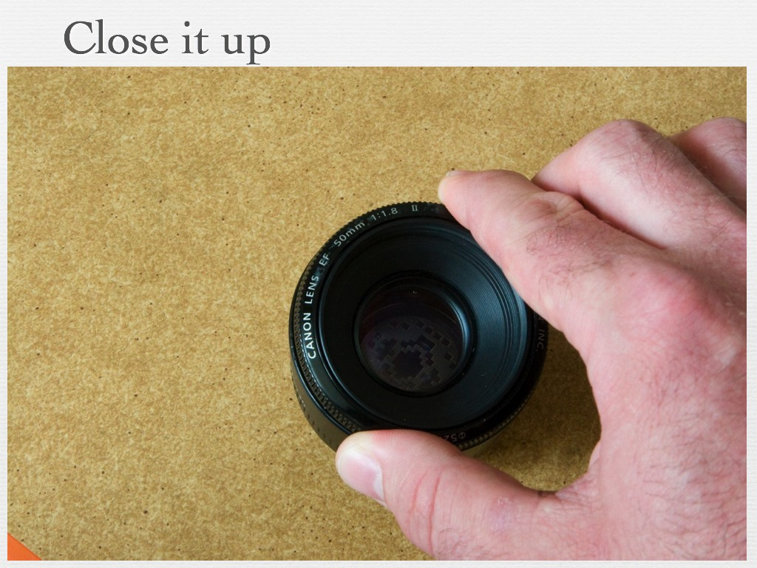
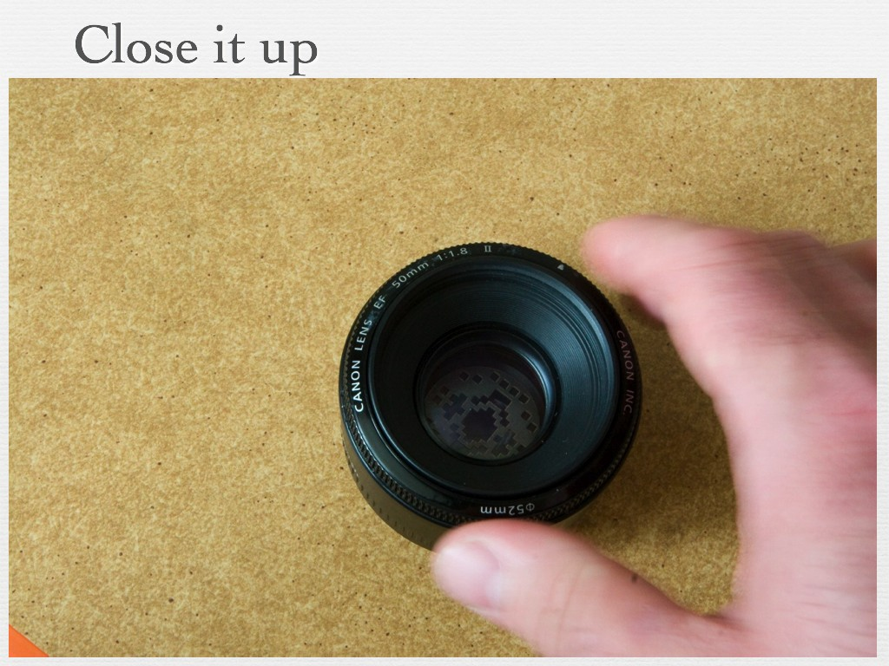
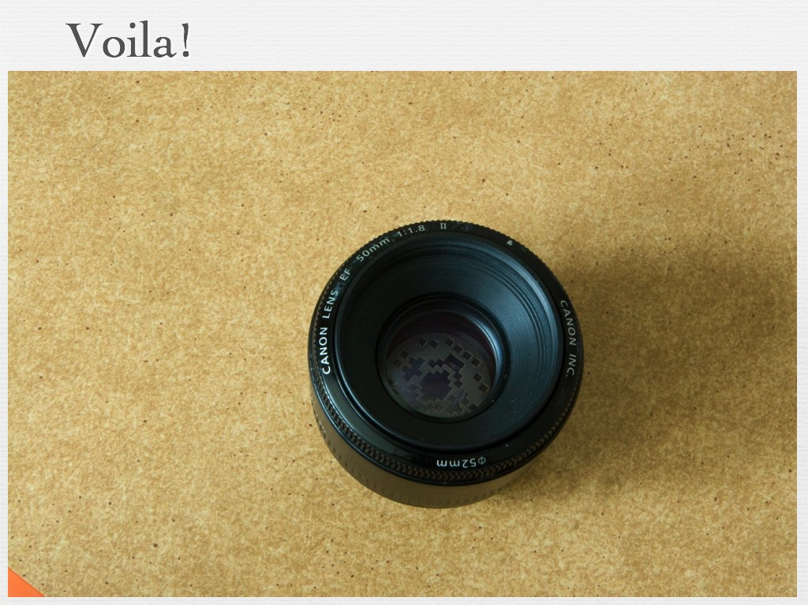

Slide 22
Coded aperture changes shape of kernel
PSF
object distance D
focus distance D’

Slide 23

Coded aperture changes shape of kernel
PSF
object distance D
focus distance D’

Slide 24
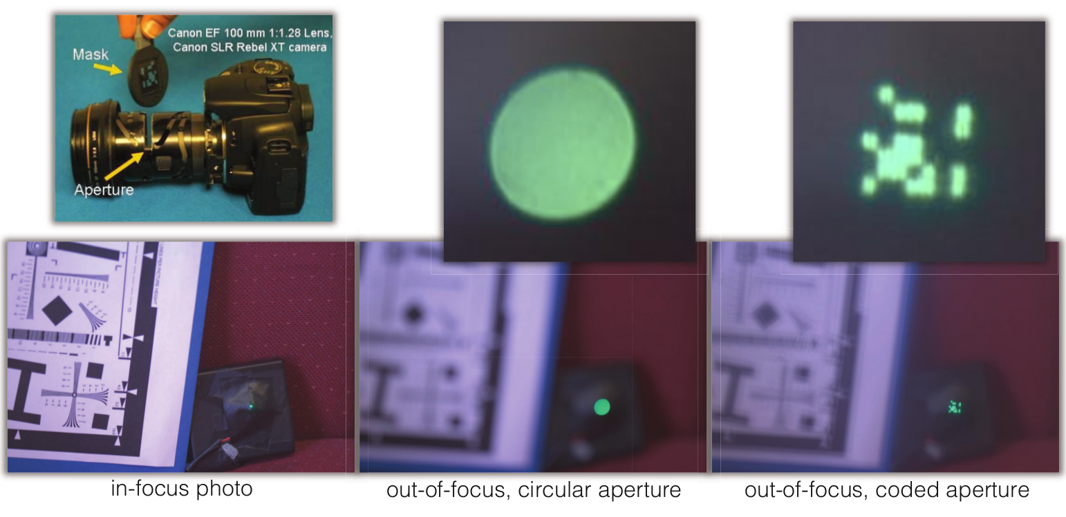
Coded aperture changes shape of PSF

Slide 25
Why are our images blurry?
Lens imperfections.
Camera shake.
Scene motion.
Depth defocus.
last lecture: deconvolution
conventional photography
last lecture: blind deconvolution
flutter shutter, motion-invariant photo
coded photography
coded aperture, focal sweep, lattice lens

Slide 26
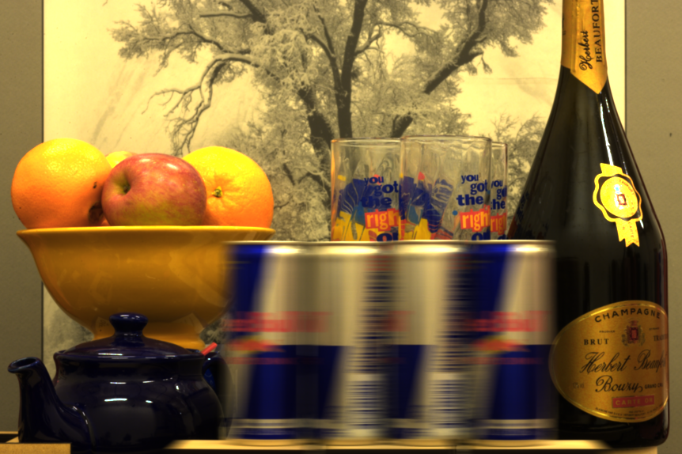
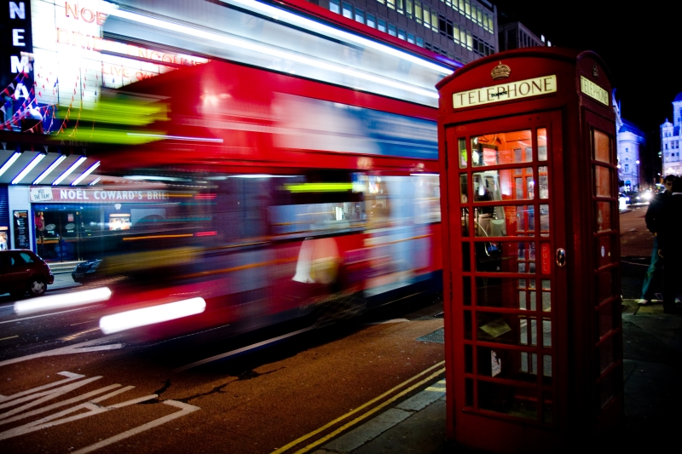
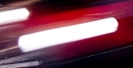
Motion blur

Slide 27
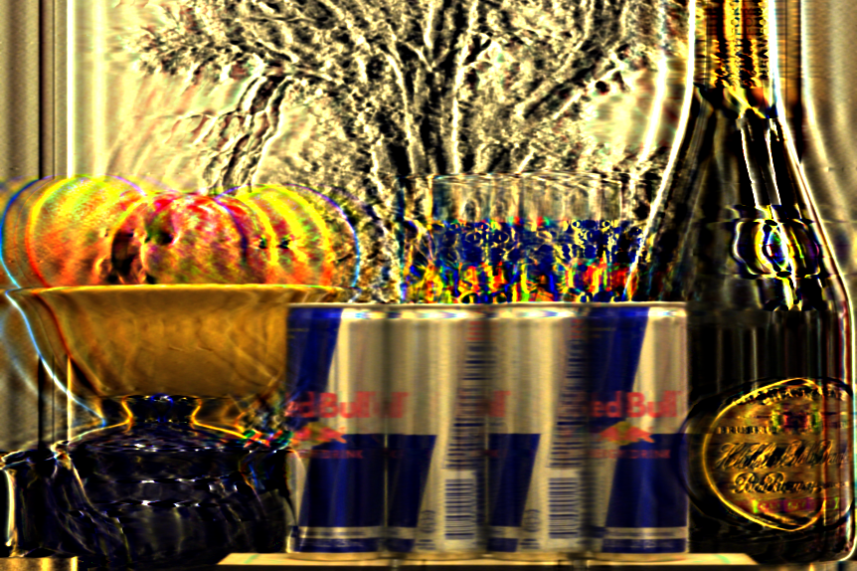
Motion blur
=
*
blurry image of moving object
motion blur kernel
sharp image of static object
What does the motion blur kernel depend on?

Slide 28
Motion blur
=
*
blurry image of moving object
motion blur kernel
sharp image of static object
What does the motion blur kernel depend on?
Motion velocity determines direction of kernel.
Shutter speed determines width of kernel.
Can we use deconvolution to remove motion blur?

Slide 29
Challenges of motion deblurring
Blur kernel is not invertible.
Blur kernel is unknown.
Blur kernel is different for different objects.

Slide 30
Challenges of motion deblurring
Blur kernel is not invertible.
Blur kernel is unknown.
Blur kernel is different for different objects.
How would you deal with this?

Slide 31
Dealing with motion blur: coded exposure

Slide 32
Coded exposure a.k.a. flutter shutter
Code exposure (i.e., shutter speed) to make motion blur kernel better conditioned.
traditional camera
=
*
blurry image of moving object
motion blur kernel
sharp image of static object
flutter-shutter camera
=
*
blurry image of moving object
motion blur kernel
sharp image of static object

Slide 33
How would you implement coded exposure?

Slide 34
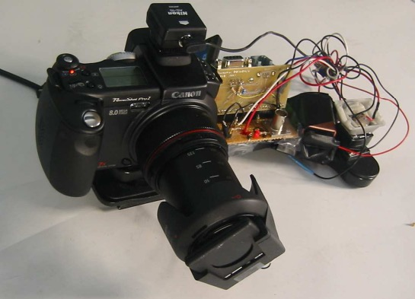
How would you implement coded exposure?
electronics for external shutter control
very fast external shutter

Slide 35

Coded exposure a.k.a. flutter shutter
motion blur kernel in time domain
motion blur kernel in Fourier domain
Why is flutter shutter better?

Slide 36
Coded exposure a.k.a. flutter shutter
motion blur kernel in time domain
zeros make inverse filter unstable
motion blur kernel in Fourier domain
inverse filter is stable
Why is flutter shutter better?

Slide 37

Motion deblurring comparison
conventional photography
flutter-shutter photography
deconvolved output
blurry input

Slide 38


Slide 39


Slide 40


Slide 41



Application: Aerial Imaging
Sharpness versus Image Pixel Brightness
Long Exposure:
The moving camera creates smear
Time = T
Time = 0
Shutter Open
Shutter Closed
Time
Short Explosure: Avoids blur. But the image is dark
Shutter Open
Shutter Closed
Time
Time
Solution: Flutter Shutter
Goal: Capture sharp image with sufficient brightness using a camera on a fast moving aircraft
Shutter Open
Shutter Closed
Time

Slide 42
Alternative to flutter shutter?

Slide 43



Slide 44



B == Blurring, at the pixel
alpha == light lost due to transmission through the atmosphere
A == ”airlight” --- light coming not from the object but the air between you and the object.
N = noise
Delta_t(p) is local deformations due to camera shake or refraction

Slide 45
B == Blurring, at the pixel
alpha == light lost due to transmission through the atmosphere
A == ”airlight” N = noise
Delta_t(p) is local deformations due to camera shake or refraction

Slide 46


Slide 48
PCA
Incredibly useful linear algebra tool.
Used in machine learning, for
Dimensionality reduction
Clustering
Recognition
…

Slide 49
PCA idea:
Given: a collection of sample images, {I₁,…I_{n}}
Find:
A mean image μ,
and a collection of principle components {B₁, B₂, …B_{k}}, such that:
Each sample image I_{i} can be approximated as:
I_{i} = μ + c_{1,i} B_{1,i} + c_{2,i} B₂ + … c_{κ,i} B_{κ}
c₁, c₂, … c_{k} are coefficents.
Each image has different coefficients.
But the whole *set* of images shares the same principle components.

Slide 50
I = μ + c₁ B₁ + c₂ B₂ + … c_{κ} B_{κ}
This literally means that I want to recreate I_{i} by adding other images together.
This creates a “space of images” spanned by a mean image and set of principle components.
That space of images is formed by choosing all possible combinations of the coefficients c₁, c₂, … c_{k}

Slide 51




Grounding Example 1
I₁
I₂
I_{i} = μ + 1 B₁
μ
B₁

Slide 52

Grounding Example 1 (do matlab instead!)
I₁
I₂
I₂ = μ + -1 B₁
μ
B₁

Slide 53
I_{i} = μ + c_{1,i} B₁ + c_{2,i} B₂ + … c_{κ,i} B_{κ}
What set of principle images {B₁, B₂, …B_{k}} is best?
A reasonable goal is to minimize the reconstruction error, so we’d like to choose {B₁, B₂, …B_{k}} so that:
Σ_{i}(I_{i}- (μ + c_{1,i} B₁ + c_{2,i} B₂ + … c_{k,i} B_{k})), which is
Σ_{i}(I_{i}- (reconstructed I₁))² is minimized.
In 2-d what is this?

Slide 54
SVD
D
U
S
V
=
Given any matrix D, solves for the U,S,V minimizing:
||D – U S V||_{F}
_{What is the Frobenius norm?!}

Slide 55
I_{i} = μ + c_{1,i} B₁ + c_{2,i} B₂ + … c_{κ,i} B_{κ}
Basis creates mapping between images and (a few) coefficients…
“Dimensionality reduction algorithm”.
I_{i} → c_{1,I}, c_{2,i} ,… ,c_{κ,I}

Slide 56
How to actually do this…
Principle component analysis.
Images are in a 3D matrix I(x,y,t).
Compute the mean image and subtract it from each image.
Change that matrix into a data matrix D(p,t),
listing the pixel values in each frame.
Do the “SVD” decomposition:
D = U S V
Frame 2 coefficients.
Frame 1 coefficients.
D
U
S
V
coefficients
=
Images
Basis Images

Slide 57
D
U
S
V
=
S is a diagonal matrix, so it only has diagonal elements, called singular values.
These numbers are the relative importance of each of the principle components.
If we want we can make the principle components be the columns of U * S, and have the columns of V be the coefficients.
Alternatively, we can keep the columns of U, and make the coefficients be S * the columns of V. This is more common.

Slide 58
D
U
S
V
coefficients.
=
Images
Basis Images
Special properties:
U,V are both orthonormal matrices.
This is cool:
Given a new image W, to get its coefficients v_{w}, you can use:
v_{w}=U^{T}W
Then U v_{w} approximately reconstructs W. Why?
U v_{w}
= U (U^{T}W)
= (U U^{T})W
= I W
= W.

Slide 59
D
U
S
V
coefficients
=
Basis Images
These coefficients define the appearance of the image.
The U matrix defines the space of possible images within this video.
Given a new set of coefficients ( a new column of V ), we can make a new image.
New image = U v
(this will give us a column vector of the pixel values…
you have to rearrange it into the shape of the image).
Given a new image W we can find its coefficients
v = U^{T}W

Slide 60
PCA Math – Going back to slide 1
Principle component analysis.
Images are in a 3D matrix I(x,y,t).
Change that matrix into a data matrix D(p,t), listing the pixel values in each frame.
Do the “SVD” decomposition:
D = U S V
Frame 2 coefficients.
Frame 1 coefficients.
D
U
S
V
coefficients
=
Images
Basis Images

Slide 61
Calculating the SVD consists of finding the eigenvalues and eigenvectors of DD^{T} and D^{T}D.
The eigenvectors of D^{T}D make up the columns of V,
The eigenvectors of DD^{T} make up the columns of U
So who remembers eigenvectors?
mathy types: “oh, of course, they are the vectors v such that Mv = λv”.
(some matlab hacking to come…).

Slide 62

PCA for faces
Images courtesy of OpenCV tutorial at CVPR-2001

Slide 63

PCA reconstruction
Images courtesy of OpenCV tutorial at CVPR-2001

Slide 64


Slide 65


Slide 66


Slide 67

Wash U. (Camera Location)
Med School
St. Louis University
Downtown/Arch

Slide 68

Recognition
PCA
Project images into low-D space
this represents the image DB
individuals (obj., people) in the database live in that volume
often, they “undulate” or “weave” through it, depending on pose, lighting, expressions, etc.
(1) match new images to classes
(2) represent object classes efficiently
Image coefficient space
We need to

Slide 69


















scene tensor factorization
[
]
[
]
[
]
≈
[
]
[
]
[
]
[
]
Dawn
Dusk
Dawn
Dusk

Slide 70






consistent labeling using tensor factorization
R
G
B
Dawn
Dusk

Slide 71

Camera 1
Camera 2
Camera 3
Camera 4
1 day
Jacobs, Roman, Pless. Consistent temporal variations in many outdoor scenes. CVPR 2007

Slide 72
examples of consistent labeling

